Slide 1
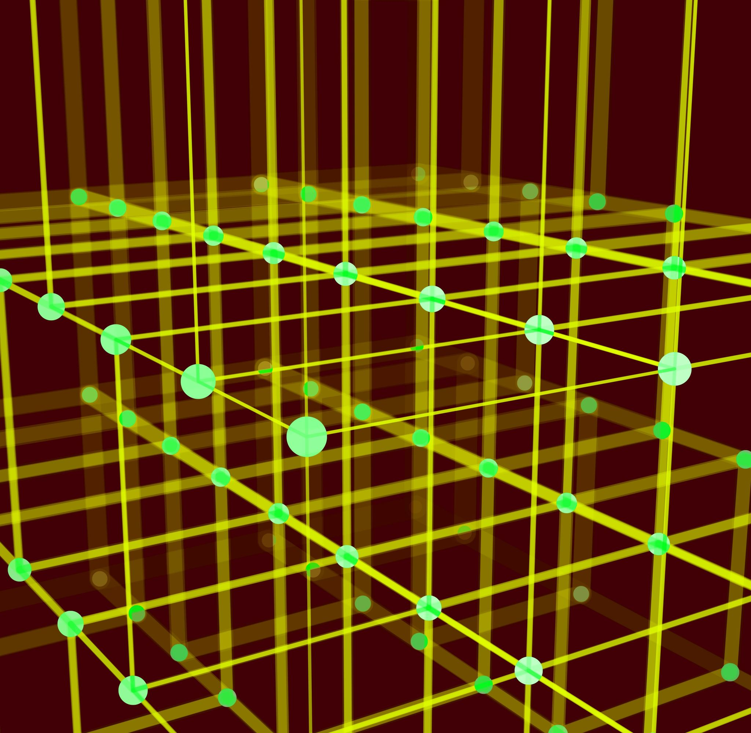
Spatial relation vector
Jingyuan Sha

Slide 2
Introduction
VQA: Human asks system to answer questions
This project attempts to have the system learn rules and solve the task itself.
The system observes nature and then draws conclusions from nature.

Slide 3
Important Dates
Abstract submission: 6 March 2023
Paper submission deadline: 13 March 2023 (Anywhere on Earth)
Author Notification: 22 April 2023
Camera-ready paper due: 12 May 2023 (Anywhere on Earth)
NeSy Workshop dates: 3-5 July 2023

Slide 4
Pipeline
Scene detection: for each object in each scene, the basic properties must be known
Shape
position (2D, 3D)
Color
Size
Design rules, and learn the rules
Learn the relationship between any two objects
Use the rules to correct random scenes
Reposition the objects to match the learned rules
Visualize the repositioned scene.

Slide 5
Titles
Neural-Symbolic Predicate Invention from Visual Scenes
Visual Scene Logical Programming through Predicate Invention

Slide 6
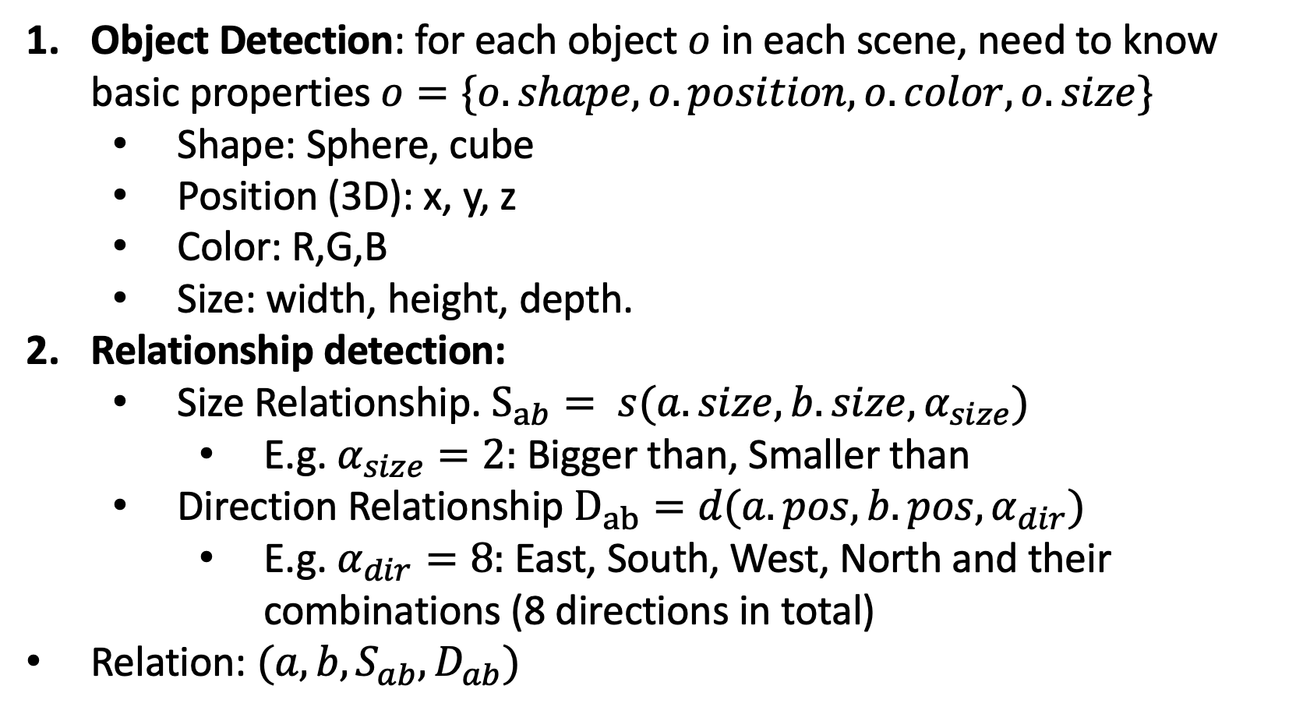
Experiment 1
Scene Detection
Object Detection: for each object $o$ in each scene, need to know basic properties $o=\{o.shape, o.position, o.color, o.size\}$
Shape: Sphere, cube
Position (3D): x, y, z
Color: R,G,B
Size: width, height, depth.
Relationship detection:
Size Relationship. $S_{ab}= s(a.size,b.size, α_{size})$
E.g. $α_{size}=2:$ Bigger than, Smaller than
Direction Relationship $D_{ab}=d(a.pos,b.pos, α_{dir})$
E.g. $α_{dir}=8:$East, South, West, North and their combinations (8 directions in total)
Relation: $(a, {b, S}_{ab},D_{ab})$
Northeast, smaller
North, smaller
Northeast, smaller
Northeast, bigger

Slide 7
7
4
3
0
2
1
6
5
8-Zone
32-Zone

Slide 8
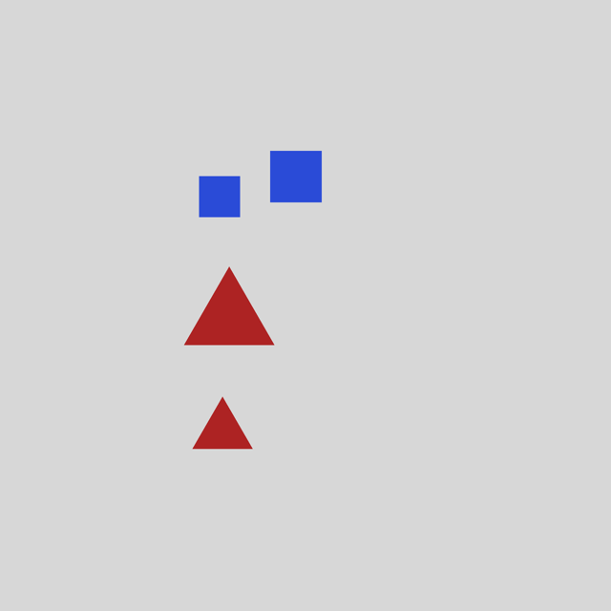
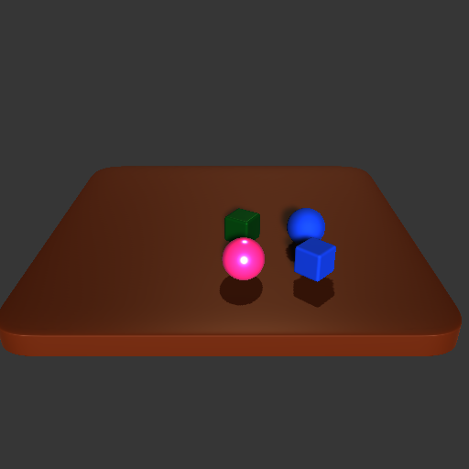
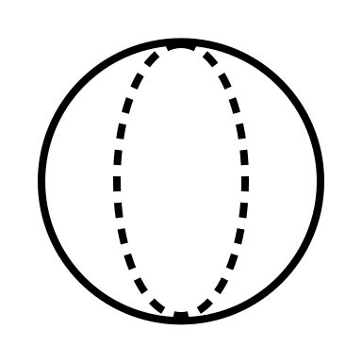
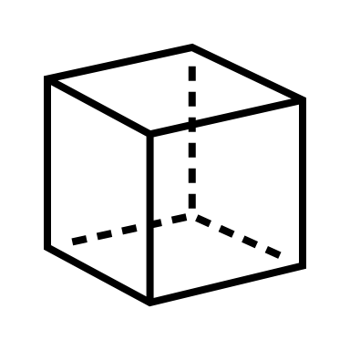

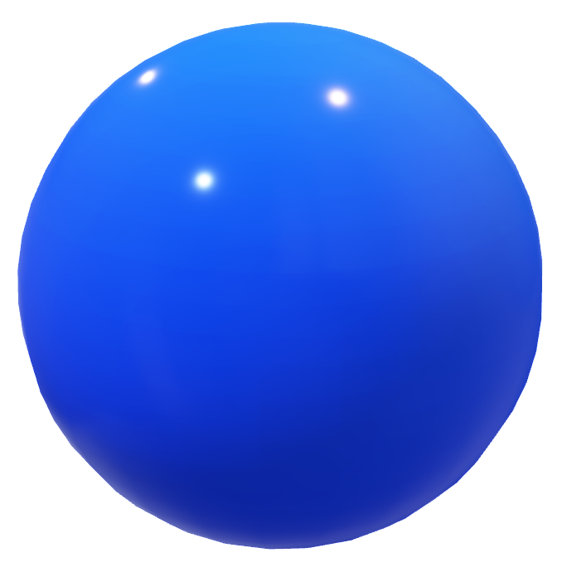
Northeast, bigger
Northeast, smaller
North, smaller
Northeast, smaller
32-Zone

Slide 9
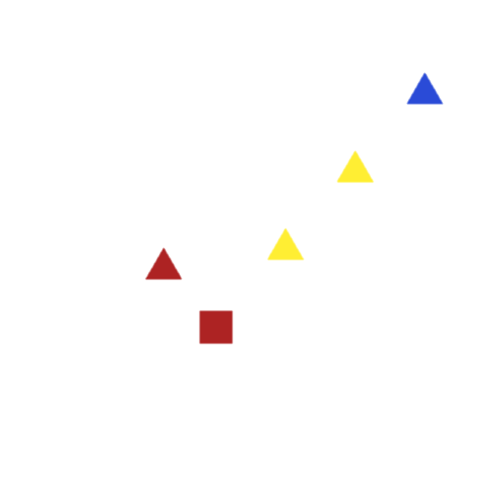
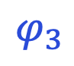
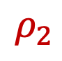
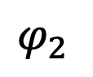
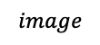
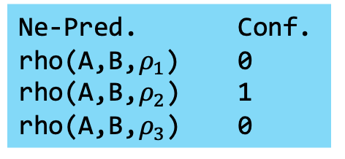
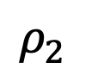
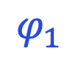

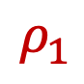
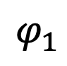
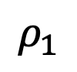
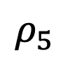
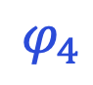
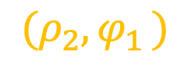
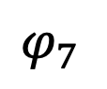
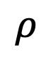
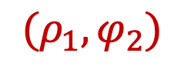
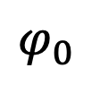
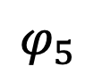
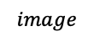
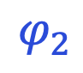
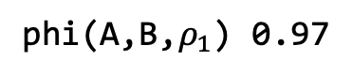
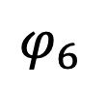

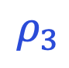
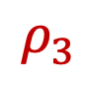
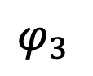
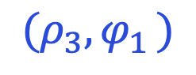
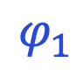
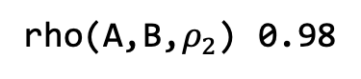
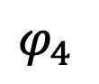
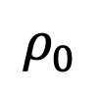
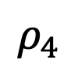
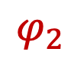
x
0
A: [..., 0.4,0.6, ...]
B: [..., 0.6,0.3, ...]
Ne-Pred. Conf.
rho(A,B,$ρ_{1}$) 0
rho(A,B,$ρ_{2}$) 1
rho(A,B,$ρ_{3}$) 0
(0.6, 0.3)
1
B
(0.4, 0.6)
A
$$φ_{1}$$
Image
Perception Predictions
$$φ_{2}$$
$$(ρ_{2}{,φ}_{1})$$
y
$$ρ_{2}$$
B
$$ρ_{1}$$
A
$$ρ_{3}$$
$$φ_{4}$$
$$φ_{3}$$
$$φ_{7}$$
$$φ_{0}$$
$$ρ_{5}$$
$$ρ_{4}$$
$$ρ_{2}$$
$$φ_{1}$$
$$ρ_{1}$$
$$φ_{6}$$
$$ρ_{0}$$
$$image diagonal$$
$$φ_{5}$$
$$φ_{2}$$
$$image$$
$$image$$
$$φ_{4}$$
$$φ_{3}$$
argmax
rho(A,B,$ρ_{2}$) 0.98
$$(ρ_{3}{,φ}_{1})$$
argmax
phi(A,B,$ρ_{1}$) 0.97
$$ρ_{3}$$
$$φ_{2}$$
$$φ_{1}$$
$${(ρ_{1},φ}_{2})$$
$$ρ_{1}$$
$$ρ$$

Slide 10
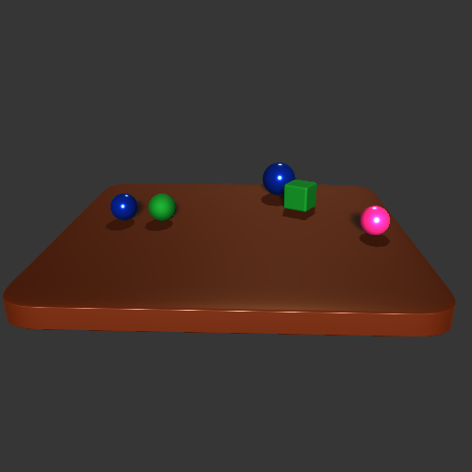
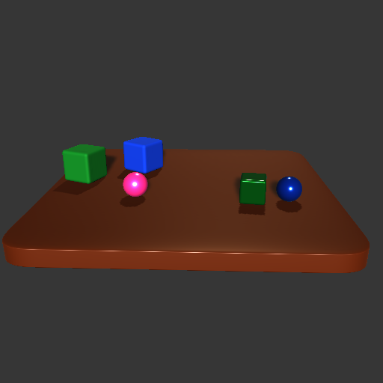
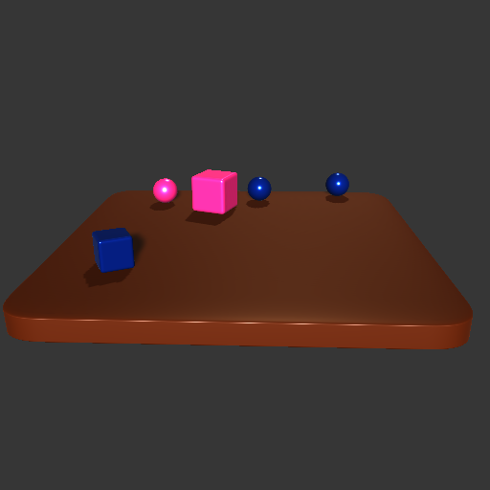
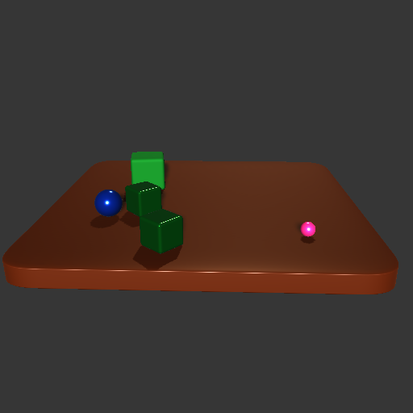
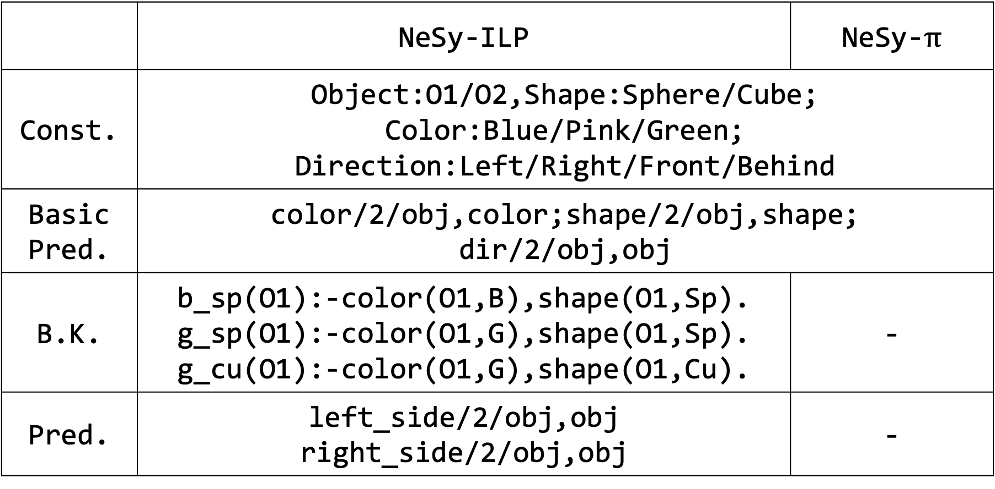
 | NeSy-ILP | NeSy-$π$
Const. | Object:O1/O2,Shape:Sphere/Cube; Color:Blue/Pink/Green; Direction:Left/Right/Front/Behind
Basic Pred. | color/2/obj,color;shape/2/obj,shape; dir/2/obj,obj
B.K. | b_sp(O1):-color(O1,B),shape(O1,Sp). g_sp(O1):-color(O1,G),shape(O1,Sp). g_cu(O1):-color(O1,G),shape(O1,Cu). | -
Pred. | left_side/2/obj,obj right_side/2/obj,obj | -

Slide 11
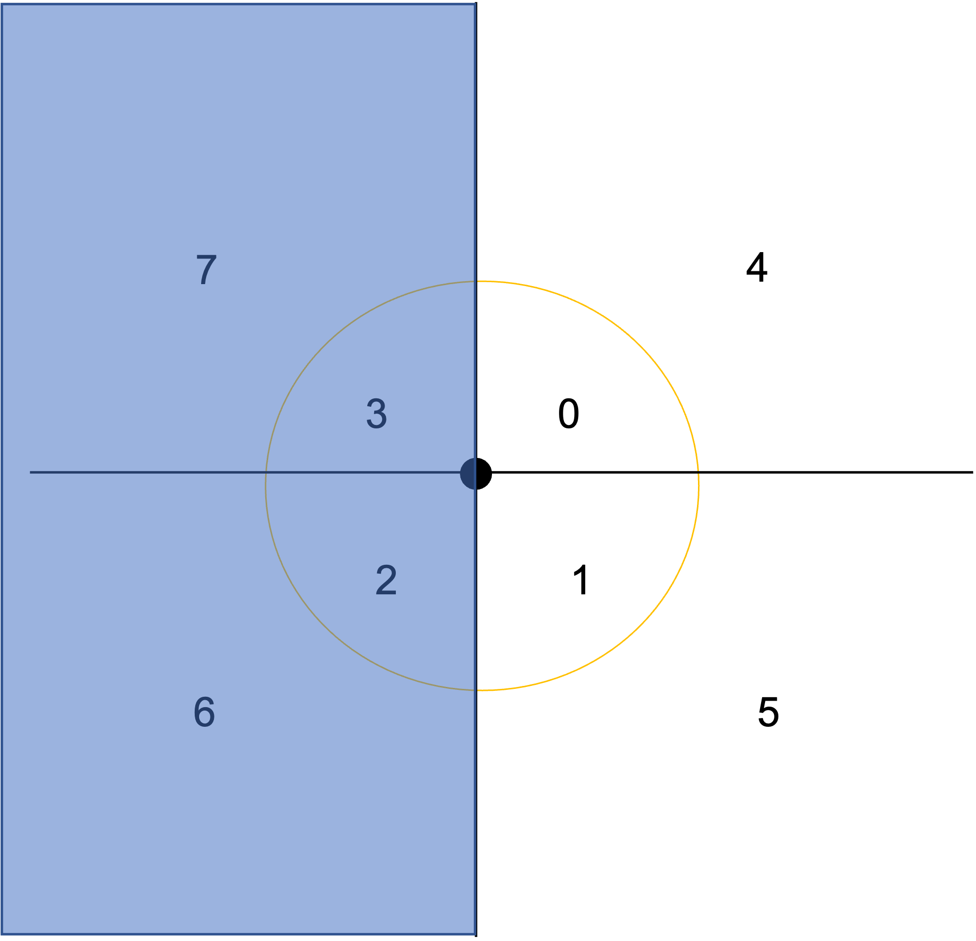
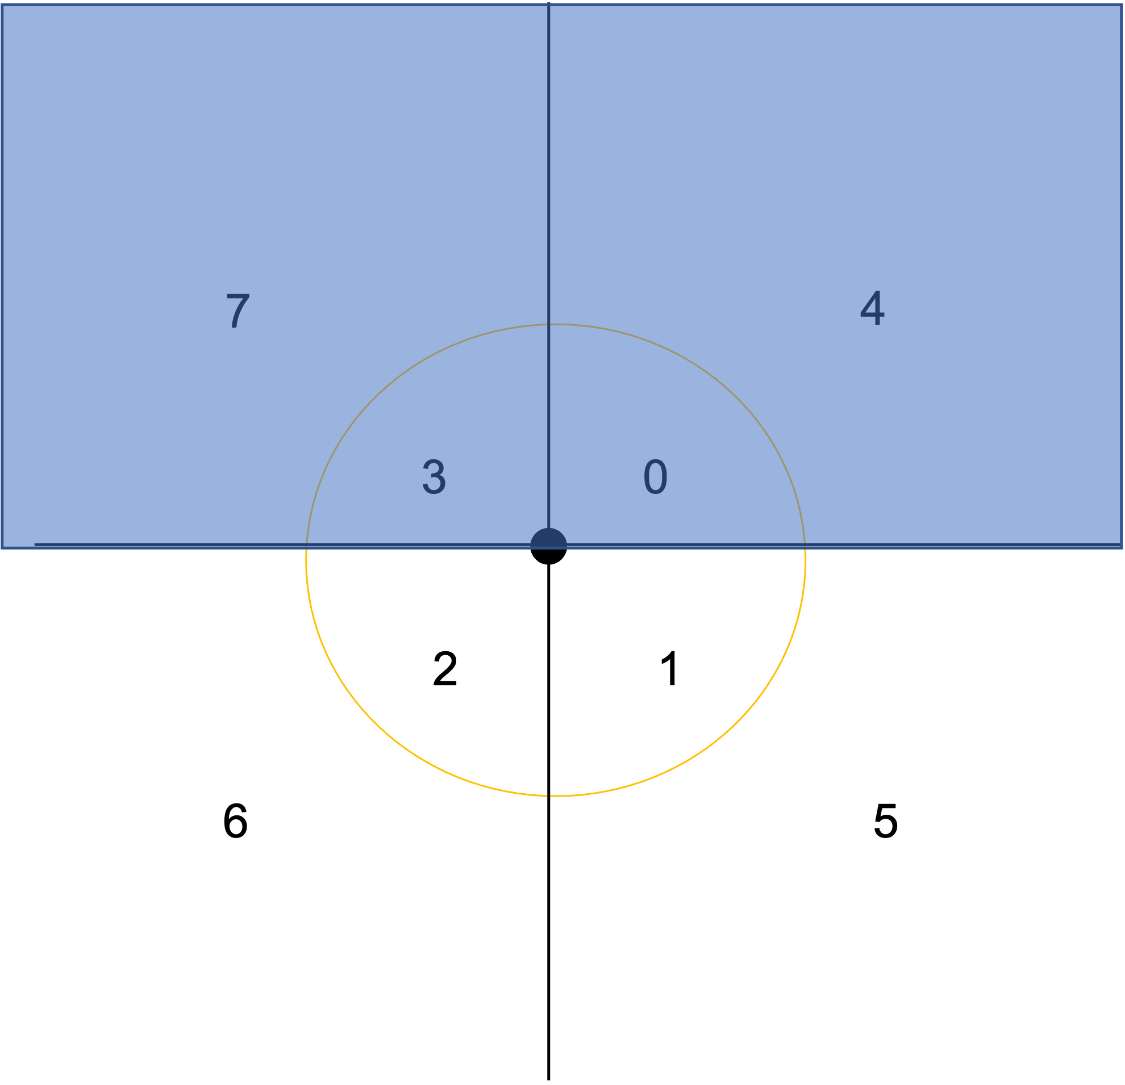
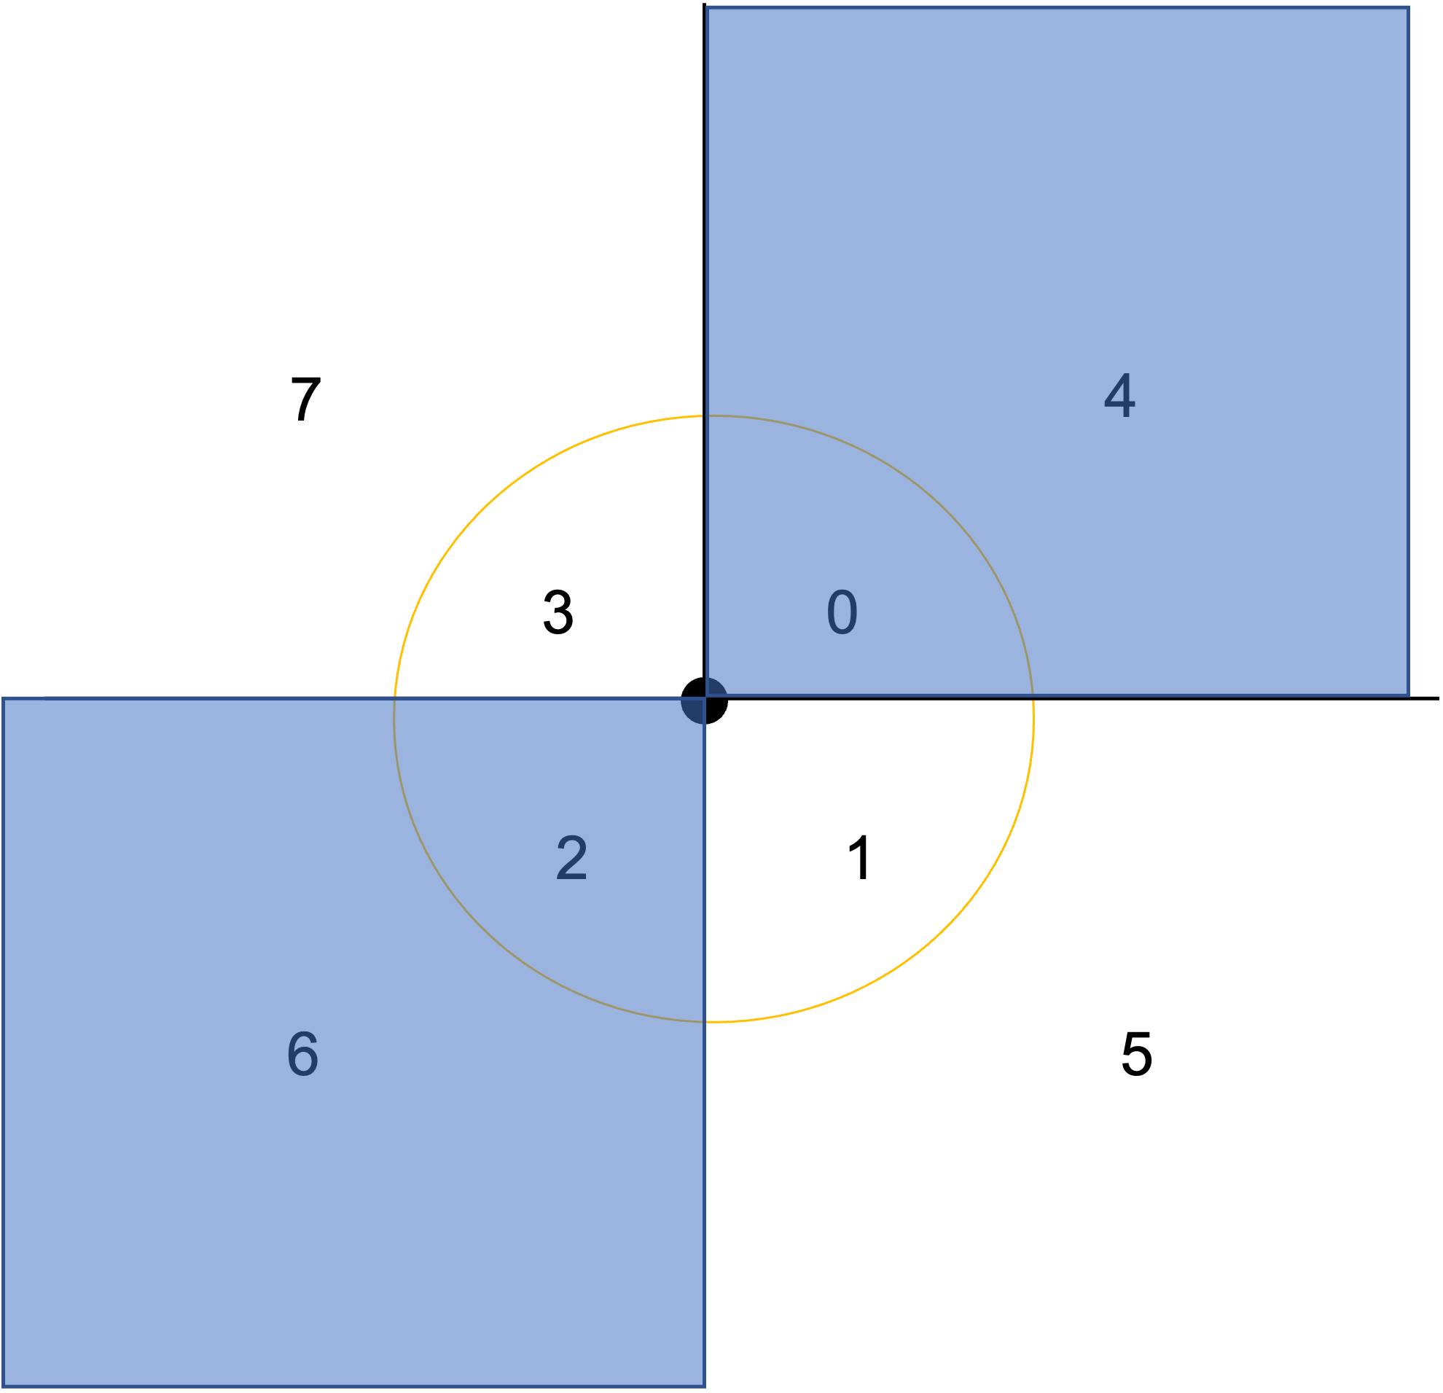
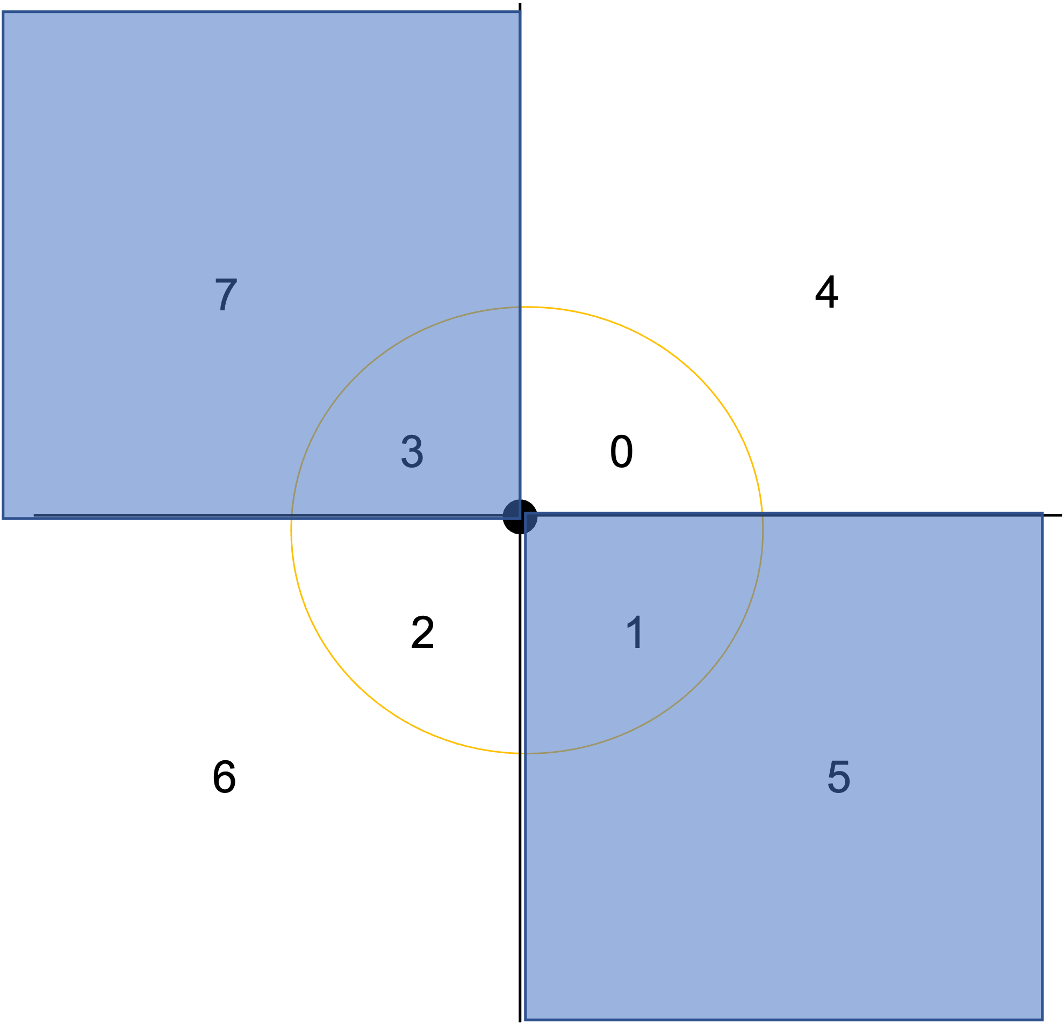
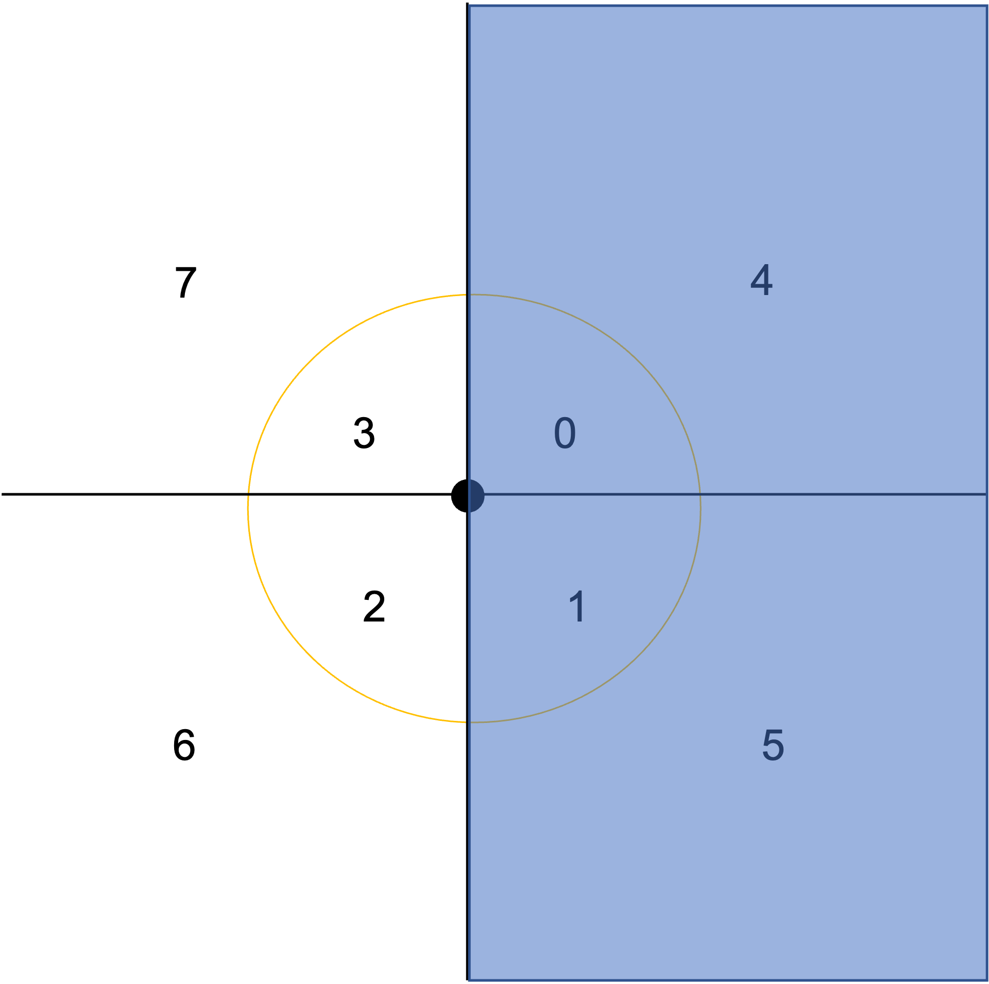



7
4
3
0
2
1
6
5
8-Zone

Slide 12
7
4
7
4
3
0
3
0
2
1
2
1
6
5
6
5

Slide 13
7
4
7
4
3
0
3
0
2
1
2
1
6
5
6
5

Slide 14
7
4
7
4
3
0
3
0
2
1
2
1
6
5
6
5

Slide 15
7
4
4
7
3
0
3
0
2
1
2
1
6
5
6
5

Slide 16
7
4
7
4
3
0
3
0
2
1
2
1
6
5
6
5

Slide 17


PI by Clustering
7
4
3
0
2
1
6
5
8-zone
NSFR generated Clauses
PI Clauses
Given an 8-zone map, the NSFR system is able to give use some clauses.
PI by Clustering is going to find concept “nearby” by invent new predicate corresponding to following clauses.

Slide 18

background knowledge
init clauses
ILP
updated programs
NSFR
target program
new concepts
(invented predicates)
PI
init clauses
ILP
updated programs
NSFR
4SM
target program

Slide 19
Initial clause
extended clauses
Evaluation
Prune
target clause
clustered clauses
Evaluation
prune
New Predicates
language
extension
cluster
eval
eval
eval
prune
prune

Slide 20







init clauses
init clauses
same shape
same shape
same shape
same shape
positive
different shape
background knowledge
same color
negative
different color
different shape
same color
different color

Slide 21
const | Color: blue/pink/green Shape: sphere/cube Object: O1/O2
background knowledge | blue_sphere(O1):-Color(O1,blue),Shape(O1,sphere). green_sphere(O1):-Color(O1,green),Shape(O1,sphere). green_cube(O1):-Color(O1,green),Shape(O1,cube).
neural predicates | left_side(O1,O2),right_side(O1,O2), Color(O1,color1),Shape(O1,shape1)
Target Clauses | target(O1,O2):-left_side(O1,O2), green_sphere(O2), blue_sphere(O1). target(O1,O2):-right_side(O1,O2), green_cube(O1),blue_sphere(O2).
for journal version
pentagon
pi shape
counter predicate
pruning strategy

Slide 22

Systems | NeSy-ILP | NeSy-$π$
const | Color: blue/pink/green, Shape: sphere/cube, Object: O1/O2
background knowledge | blue_sphere(O1):-Color(O1,blue),Shape(O1,sphere). green_sphere(O1):-Color(O1,green),Shape(O1,sphere). green_cube(O1):-Color(O1,green),Shape(O1,cube).
neural predicates | left_side(O1,O2),right_side(O1,O2), Color(O1,color1),Shape(O1,shape1)
Target Clauses | target(O1,O2):-left_side(O1,O2), green_sphere(O2), blue_sphere(O1). target(O1,O2):-right_side(O1,O2), green_cube(O1),blue_sphere(O2).

Slide 23






Red Triangle
pos(X) :- in(O1,X),in(O2,X),
closeby(O1,O2),
color(O1,red),shape(O1,triangle),
diff_shape_pair(O1,O2),
diff_color_pair(O1,O2).
closeby(O1,O2) :- in(O1,X),in(O2,X),
at_area_01(O1,O2), at_area_00(O1,O2), at_area_02(O1,O2), at_area_03(O1,O2)
(O1, O2 same order)

Slide 24

target(A,B) :- triangle(A), square(B)
Each PN-pair consists of one positive image and one negative image.
Each clause evaluates on NP-pairs, the result is a 2-element tuple, which can also map to Cartesian coordinates, called Clause Point.
One clause gets one clause point on one NP-pair.
Similarly , one clause gets 20 clause points on 20 NP-pairs.
Positive Image
Negative Image
PN-Pair
0.92
0.8
target(A,B) :- triangle(A), square(B)
0.98
0.12
target(A,B) :- triangle(A), square(B)
0.23
0.21
target(A,B) :- triangle(A), square(B)
Score on positive image corresponds x-axis, score on negative image corresponds y-axis.
For 20 NP-pairs, we get 20 clause points to draw. As shown in the scatter figure above.

Slide 25







target(image) :- shape(O1, Sphere), color(O1, Green), in(O1, Image)
0.12
0.93
0.98
Positive Image
…
0.92
0.21
0.95
PN-Vector: (5,4,4,45)
Negative Image
$$h(V)$$
…
PN-Pair 01
PN-Pair 02
PN-Pair N
Necessary Clauses

Slide 26




target(image) :- shape(A, circle), color(A, blue), in(A, image)
0.12
0.18
0.93
0.98
Positive Image
0.92
0.10
0.21
0.95
Negative Image
(1,0): 4
PN-Pair
(0,0)
(0,1)
(1,1)

Slide 27
target(A,B) :- triangle(A), square(B)
Each PN-pair consists of one positive image and one negative image.
Each clause evaluates on NP-pairs, the result is a 2-element tuple, which can also map to Cartesian coordinates, called Clause Point.
One clause gets one clause point on one NP-pair.
Similarly , one clause gets 20 clause points on 20 NP-pairs.
Positive Image
Negative Image
PN-Pair
0.92
0.8
target(A,B) :- triangle(A), square(B)
0.98
0.12
target(A,B) :- triangle(A), square(B)
0.23
0.21
target(A,B) :- triangle(A), square(B)
Score on positive image corresponds x-axis, score on negative image corresponds y-axis.
For 20 NP-pairs, we get 20 clause points to draw. As shown in the scatter figure above.

Slide 28

Clause Value Heatmap
We can also use a heatmap to re-draw the scatter figure, as shown below.
If we fuzzy the values to 4 zones.
We can see that, the black zone, which has the highest value, corresponds the case of positive score high, and negative score low. It tells us that, this clause get high score in the positive image but low score in the negative image in the most of times.

Slide 29




Clause Sign Evaluation (for Clustering PI)
Positive clause Value Heatmap
Negative clause Value Heatmap

Slide 30
Strict Positive
Strict Negative
General Positive
General Negative
The 4-zone map of a target clause
For N pairs PN-pair,
Strict Positive Clause: Written as distribute vector (0, N, 0, 0)
General Positive Clause: Written as distribute vector (0, X, 0, Y), X+Y=N
Strict Positive Clause is a General Positive Clause.
A target clause, is a strict positive clause, i.e. only get high score on positive image but low score on negative image, all the clause points are Strict positive
An invented clause, can be a general positive clause, i.e. it should get high score on positive image, but also might get high score on negative images.

Slide 31

Strict Positive
Strict Negative
General Positive
General Negative
For N PN-pairs,
strict positive clause, (0,20,0,0)
General positive clause, (0, X, 0, Y), X + Y = N
Positive Accuracy: $\frac{(X+Y)}{N} × 100\%$
Predicate evaluation:
Keep invented clause with positive accuracy equal to 100%.

Slide 32
NSFR+PI
Invented Clauses
Images
Beam searched Clauses
NSFR
Clause Generator
Languages
Invented Predicates
Update Language
Eval. Score
Good Predicates
train

Slide 33
Predicate Invention Evaluation Flow
extend
Sufficient Clauses
extend
cluster
Sufficient and Necessary Clauses
Clauses
extend
Necessary Clauses
cluster
cluster

Slide 34
Predicate Invention Evaluation Flow
Clauses
cluster
extend
cluster
Sufficient Clauses
New Predicate
Necessary Clauses
extend
extend
Clauses
extend
Sufficient and Necessary Clauses

Slide 35
Predicate Invention Evaluation Flow
Clauses
Extend
Sufficient Clauses
Clauses
extend
cluster
Remove conflict, duplicate
Clauses
Clauses
Sufficient and Necessary Clauses
others
Cluster
Clauses
extend
extend
cluster
Evaluation
Necessary Clauses
Clauses Scores
classification
cluster
Necessary Clauses
Clause Classes
S(:,1) = N
S(0,1) = N
S(0,:) = N
Sufficient Clauses
Sufficient and Necessary Clauses

Slide 36
Predicate Invention Evaluation Flow
Clauses
cluster
Extend
Sufficient Clauses
Clauses
extend
or
Remove conflict, duplicate
Clauses
Clauses
Sufficient and Necessary Clauses
others
Cluster
Clauses
extend
and
cluster
Evaluation
Necessary Clauses
Clauses Scores
classification
cluster
Necessary Clauses
Clause Classes
S(:,1) = N
S(0,1) = N
S(0,:) = N
Sufficient Clauses
Sufficient and Necessary Clauses

Slide 37
NSFR+PI
Beam searched Clauses
Invented Clauses
Images
NSFR
Clause Generator
NSFR
Clause Points
Positive Accuracy
Selected Clauses
Languages
Invented Predicates
Update Language
Eval. Score
Good Predicates
Beam Search Clauses
Invented Clauses
train

Slide 38
Beam Search Clauses
Non-target related clauses
======= BEAM SEARCHED CLAUSES ======
(BS Clause) kp(X):-at_area_4(O1,O2),in(O1,X),in(O2,X).
(BS Clause) kp(X):-at_area_5(O1,O2),diff_shape_pair(O1,O2),in(O1,X),in(O2,X).
(BS Clause) kp(X):-at_area_6(O1,O2),diff_color_pair(O1,O2),diff_shape_pair(O1,O2),in(O1,X),in(O2,X).
(BS Clause) kp(X):-at_area_6(O1,O2),diff_color_pair(O1,O2),in(O1,X),in(O2,X).
(BS Clause) kp(X):-at_area_6(O1,O2),in(O1,X),in(O2,X).
(BS Clause) kp(X):-at_area_7(O1,O2),diff_shape_pair(O1,O2),in(O1,X),in(O2,X).
(BS Clause) kp(X):-color(O1,red),diff_color_pair(O1,O2),diff_shape_pair(O1,O2),in(O1,X),in(O2,X).
(BS Clause) kp(X):-color(O1,red),diff_color_pair(O1,O2),in(O1,X),in(O2,X),shape(O1,triangle).
(BS Clause) kp(X):-color(O1,red),diff_shape_pair(O1,O2),in(O1,X),in(O2,X).
(BS Clause) kp(X):-diff_color_pair(O1,O2),diff_shape_pair(O1,O2),in(O1,X),in(O2,X),shape(O1,triangle).
(BS Clause) kp(X):-diff_color_pair(O1,O2),in(O1,X),in(O2,X),shape(O1,triangle).
(BS Clause) kp(X):-diff_shape_pair(O1,O2),in(O1,X),in(O2,X).
(BS Clause) kp(X):-in(O1,X),in(O2,X),same_shape_pair(O1,O2).
…
====== 30 clauses are generated!! ======
Target related clauses

Slide 39
Twopairs
Iteration 0
inv_pred1(O1):-color(O1,blue),in(O1,X).
inv_pred1(O1):-color(O1,yellow),in(O1,X).
inv_pred2(O1):-color(O1,blue),in(O1,X).
inv_pred2(O1):-color(O1,red),in(O1,X).
inv_pred3(O1):-color(O1,blue),in(O1,X).
inv_pred3(O1):-color(O1,yellow),in(O1,X).
inv_pred3(O1):-in(O1,X),shape(O1,circle).
Iteration 1
inv_pred58(O1,O2):-in(O1,X),in(O2,X),shape(O1,circle),shape(O2,circle).
inv_pred58(O1,O2):-in(O1,X),in(O2,X),shape(O1,triangle),shape(O2,triangle).
inv_pred59(O1,O2):-in(O1,X),in(O2,X),shape(O1,square),shape(O2,square).
inv_pred59(O1,O2):-in(O1,X),in(O2,X),shape(O1,triangle),shape(O2,triangle).
inv_pred1388(O1):-color(O1,red),in(O1,X),inv_pred2(O1).
inv_pred1388(O1):-in(O1,X),inv_pred0(O1),inv_pred3(O1).
inv_pred1389(O1):-color(O1,red),in(O1,X),inv_pred2(O1).
inv_pred1389(O1):-color(O1,yellow),in(O1,X),inv_pred1(O1).
inv_pred1389(O1):-in(O1,X),inv_pred0(O1),inv_pred3(O1).
inv_pred1390(O1):-color(O1,red),in(O1,X),inv_pred2(O1).
inv_pred1390(O1):-color(O1,yellow),in(O1,X),inv_pred1(O1).
inv_pred1390(O1):-in(O1,X),inv_pred0(O1),shape(O1,square).
inv_pred29702(O1,O2):-in(O1,X),in(O2,X),inv_pred1388(O1),inv_pred1390(O1),inv_pred59(O2,O1).
inv_pred29702(O1,O2):-in(O1,X),in(O2,X),inv_pred1389(O1),inv_pred3(O1),inv_pred58(O1,O2).
inv_pred60(O1,O2):-color(O1,blue),color(O2,red),in(O1,X),in(O2,X).
inv_pred60(O1,O2):-color(O1,blue),color(O2,yellow),in(O1,X),in(O2,X).
inv_pred60(O1,O2):-color(O1,red),color(O2,yellow),in(O1,X),in(O2,X).
Iteration 3
kp(X):-in(O1,X),in(O2,X),inv_pred29702(O2,O1),inv_pred60(O1,O2).

Slide 40
Twopairs learning history
Iteration 0
inv_pred0(O1):-color(O1,blue),in(O1,X).
inv_pred0(O1):-color(O1,yellow),in(O1,X).
Iteration 1
inv_pred2(O1,O2):-in(O1,X),in(O2,X),shape(O1,square),shape(O2,square).
inv_pred2(O1,O2):-in(O1,X),in(O2,X),shape(O1,triangle),shape(O2,triangle).
inv_pred3(O1,O2):-in(O1,X),in(O2,X),shape(O1,circle),shape(O2,circle).
inv_pred3(O1,O2):-in(O1,X),in(O2,X),shape(O1,triangle),shape(O2,triangle).
Iteration 2
inv_pred4(O1,O2):-color(O1,blue),color(O2,yellow),in(O1,X),in(O2,X),inv_pred3(O1,O2).
inv_pred4(O1,O2):-color(O1,red),in(O1,X),in(O2,X),inv_pred0(O2),inv_pred2(O1,O2).
inv_pred4(O1,O2):-color(O1,red),in(O1,X),in(O2,X),inv_pred0(O2),inv_pred3(O2,O1).
inv_pred5(O1,O2):-color(O1,blue),color(O2,yellow),in(O1,X),in(O2,X),inv_pred3(O1,O2).
inv_pred5(O1,O2):-color(O1,red),in(O1,X),in(O2,X),inv_pred0(O2),inv_pred2(O2,O1).
inv_pred5(O1,O2):-color(O1,red),in(O1,X),in(O2,X),inv_pred0(O2),inv_pred3(O2,O1).
Iteration 3
sufficient and necessary clause with 0.9% accuracy: kp(X):-in(O1,X),in(O2,X),inv_pred5(O1,O2)., tensor([[ 15., 185., 0., 0.]])
sufficient and necessary clause with 0.9% accuracy: kp(X):-in(O1,X),in(O2,X),inv_pred4(O1,O2)., tensor([[ 15., 185., 0., 0.]])
sufficient and necessary clause with 0.9% accuracy: kp(X):-in(O1,X),in(O2,X),inv_pred5(O2,O1)., tensor([[ 15., 185., 0., 0.]])
sufficient and necessary clause with 0.9% accuracy: kp(X):-in(O1,X),in(O2,X),inv_pred4(O2,O1)., tensor([[ 15., 185., 0., 0.]])

Slide 41
Online-5-pair
training acc: 0.7925, threshold: 0.33, recall: [ 0.59 0.995]
val acc: 0.8472222222222222, threshold: 0.33, recall: [ 0.69444 1]
test acc: 0.8225, threshold: 0.33, recall: [ 0.645 1]

Slide 42
NSFR+PI
Beam searched Clauses
Invented Clauses
Images
NSFR
Clause Generator
NSFR
Clause Points
Positive Accuracy
Selected Clauses
Languages
Invented Predicates
Update Language
Eval. Score
General positive Clauses
with its predicates
Beam Search Clauses
Invented Clauses
train

Slide 43
NSFR+PI
Beam searched Clauses
Invented Clauses
Images
NSFR
Clause Generator
NSFR
Clause Points
Positive Accuracy
Selected Clauses
Languages
Invented Predicates
Update Language
Eval. Score
General positive Clauses
with its predicates
Beam Search Clauses
Invented Clauses
PI Generation Loop
train

Slide 44
NSFR+PI
Invented Clauses
Images
Beam searched Clauses
NSFR
Clause Generator
Languages
Invented Predicates
Update Language
Eval. Score
Good Predicates
train
Positive Images
NSFR
Positive score
Positive Clauses
PI invented Clauses
NSFR
Beam searched Clauses
Non-conflict clauses
Clause Sign Eval.
Negative Images
Negative score
Negative Clauses
NSFR
Conflict Clauses
train
Conflict Clauses: e.g. p(A,B) :- at_area_0(A, B), at_area_7(A,B) is a conflict clause, cause the atoms in the clause body contradict each other.
Clause Sign: A clause can be given a positive sign ‘+’ or a negative sign ‘-’. A clause labeled with a positive sign can be further consider for PI module, a clause labeled with a negative sign is discarded for PI module.

Slide 45

PI Clauses with positive sign
We can cluster all the PI clauses with positive sign as a new concept and invent a new predicate for it.

Slide 46
Counter
E
E
D
D
C
C
B
B
A
Inv_1(a, b, prop_1) :- One(a, prop_1), One(b, prop_1)
Inv_2 ([],prop_1) :- Inv_1(a,b), One(c, prop_1)
Inv_1(a, b, prop_2) :- One(a, prop_2), One(b, prop_2)
Inv_2 (a,b,c, prop_2) :- Inv_1(a,b, prop_2), One(c, prop_2)

Slide 47
Predicate Invention
4
5
How
Cluster Invention (Cluster any 2, 3, 4,… areas)
Inv(A,B) :- p1(A,B)
Inv(A,B) :- p2(A,B)
Repeat Chain invention
Inv(A,B) :- p(A,C), p(C,B)
Combine Chain Invention
Inv(A,B):-p_1(A,C), p_2(C,B)
Some invented predicates only appear in the negative images
0
1
2
3
6
7

Slide 48
Predicate Invention
Invent a bunch of new predicates
See if any works
If the new intent space is too large
A neural network is required for selection

Slide 49
Template Based New Predicate Invention: Clauses
with_prop_1(X):-pred_2_args_id_0(X,Y),pred_1_args_id_0(Y). with_prop_2(X,Y):-pred_3_args_id_0(X,Y,Z),pred_1_args_id_0(Z). cluster_pred(X):-pred_1_args_id_0(X). cluster_pred(X,Y):-pred_2_args_id_0(X,Y). cluster_pred(X,Y,Z):-pred_2_args_id_0(X,Y,Z). commutative(X):-pred_2_args_id_0(X,Y),pred_2_args_id_0(Y,X). commutative(Y):-pred_2_args_id_0(X,Y),pred_2_args_id_0(Y,X). prop_same(X,Y):-pred_2_args_id_0(X,Z),pred_2_args_id_0(Y,Z). prop_diff(X,Y):-pred_2_args_id_0(X,Z),pred_2_args_id_0(Y,W),pred_2_args_id_1(Z,W). pair(X,Y):-pred_2_args_id_0(X,Y),pred_2_args_id_1(Y,X). chain_same(X,Y):-pred_2_args_id_0(X,Z),pred_2_args_id_0(Z,Y). chain_diff(X,Y):-pred_2_args_id_0(X,Z),pred_2_args_id_1(Z,Y).

Slide 50
Template Based New Predicate Invention: Predicate
pred_1_args_id_0:1:object pred_1_args_id_1:1:object pred_2_args_id_0:2:object,object pred_2_args_id_1:2:object,object pred_3_args_id_0:3:object,object,object pred_3_args_id_1:3:object,object,object pred_2_args_id_0:2:object,prop pred_2_args_id_1:2:object,prop pred_3_args_id_0:3:object,object,prop pred_3_args_id_1:3:object,object,prop pred_1_args_id_0:1:prop pred_1_args_id_1:1:prop pred_2_args_id_0:2:prop,prop pred_2_args_id_1:2:prop,prop

Slide 51


Slide 52









Slide 53
Online
4
5
4
5
0
1
0
1
E
2
3
2
3
6
D
E
7
6
7
C
D
C
B
B
A
A
Inv_1(A,C) :- at_area_1(A,B), at_area_1(B,C)
Inv_1(A,D) :- Inv_1(A,C), at_area_1(C,D)
Inv_1(A,E) :- Inv_1(A,D), at_area_1(D,E)
Inv_1(A,C) :- at_area_0(A,B), at_area_0(B,C)
Inv_1(A,D) :- Inv_1(A,C), at_area_0(C,D)
Inv_1(A,E) :- Inv_1(A,D), at_area_0(D,E)
Notes:
IN this case, invention by clustering does not work well.
We can consider invention by chaining. Also likes combination.

Slide 54
Still Online?
4
5
4
5
0
1
0
1
E
2
3
2
3
E
6
7
D
6
7
D
C
A
B
C
A
B
Inv_1(A,B) :- at_area_6(A,B) (Direct Invention)
Inv_2(B,D) :- at_area_0(B,C), at_area_0(C,D) (Repeat Invention)
Inv_2(B,E) :- Inv_2(B,D), at_area_0(D,E) (Repeat Invention)
Inv_3(A,C) :- at_area_6(A,B), at_area_0(B,C) (Chain Invention)
Inv_1(A,B) :- at_area_0(A,B) (Direct Invention)
Inv_2(A,D) :- at_area_1(A,C), at_area_1(C,D) (Repeat Invention)
Inv_3(B,C):- at_area_3(B,A), at_area_1(A,C) (Chain Invention)
Notes:
There should be no chain invention in nearby relationship.

Slide 55
Still Online?
4
5
4
5
0
1
0
1
E
2
3
2
3
6
7
D
E
6
7
C
D
A
C
A
B
B
Inv_1(A,B) :- at_area_6(A,B) (Direct Invention)
Inv_2(A,D) :- at_area_1(A,C), at_area_1(C,D) (Repeat Invention)
Inv_3(B,C):- at_area_5(B,A), at_area_1(A,C) (Line Invention)
Inv_1(A,B) :- at_area_6(A,B) (Direct Invention)
Inv_2(B,D) :- at_area_0(B,C), at_area_0(C,D) (Repeat Invention)
Inv_2(B,E) :- Inv_2(B,D), at_area_0(D,E) (Repeat Invention)
Inv_3(A,C) :- at_area_6(A,B), at_area_0(B,C) (Chain Invention)
Notes:
There should be no chain invention in nearby relationship.

Slide 56



Nearby
4
5
4
5
0
1
0
1
E
D
2
E
3
2
3
6
7
D
6
7
C
C
B
A
B
A
Inv_1(A,B) :- at_area_0(A,B) not exist in the negative image
Inv_1(C,D) :- at_area_1(C,D) not exist in the negative image
Inv_1(A,C) :- at_area_5(A,C) exist in the negative image
Inv_1(A,C) :- at_area_5(A,C)
Inv_1(A,E) :- at_area_4(A,E)
Inv_1(A,D) :- at_area_5(A,D)
Notes:
If the predicate not exist in the negative image, we can use it for new predicate invention
All the positive-only predicate can be clustered together and consider as a new predicate.

Slide 57
7 Clauses | 1.94
6 Clauses | 2.05
5 Clauses | 2.13
4 Clauses | 2.13
3 Clauses | 2.06
2 Clauses | 1.90
1 Clauses | 1.74
Clause Clustering
Best score
Clustering all k clauses C={C1, …,. Ck}
For i=1 to k-1
n=len(C)
For j = 1 to k:
New_C <- Delete j-th clause in C
score <- Evaluate all the rest clauses in C
best_score <- max(score)
C <- Best_New_C
Return best combination
Clause Number
Optimal

Slide 58
Predicate Invention in Two ways
Given a concept and a dataset, learn the given concept
Given dataset, learn some concepts.
The core task is that find a bi-cut for the dataset to divide into two groups (positive, negative), the positive group satisfies some kinds of rules and negative group against the same rules.

Slide 59


Experiment 2
Design rules and learn the rules from scenes
{ "rule_objs_per_scene": 2, "random_objs_per_scene": 0, "scene_num": 20, "objs": [ { "size": "small", "shape": "sphere", "material": "matt_orange_sphere", "x": 0, "y": 0, "z": 0 }, { "size": "big", "shape": "cube", "material": "", "x": 1.5, "y": 0, "z": 0 } ] }
{ "rule_objs_per_scene": 2, "random_objs_per_scene": 0, "scene_num": 20, "objs": [ { "size": "small", "shape": "sphere", "material": "matt_orange_sphere", "x": 0, "y": 0, "z": 0 }, { "size": "big", "shape": "cube", "material": "", "x": -1.5, "y": 0, "z": 0 } ] }
Rule: Left
Rule: Right
Notes:
Take the training set more general, small ball on the right side as well.

Slide 60
Experiment 2
Design rules and learn the rules of scenes
Training batch=3
Observe the given batch scenes and summarize the rules(so far, just relationships) that exist in each scene.
Notes:
Take the training set more general, small ball on the right side as well.

Slide 61
Experiment 2
{ "premise": { "ref": [ { "name": "shape", "value": "sphere", "commonExist": false, "parentId": 0 } ], "obj": [ { "name": "shape", "value": "cube", "commonExist": false, "parentId": 1 } ] }, "conclusion": { "size": [ "bigger than, " ] }, "freq": 18 },
{ "premise": { "ref": [ { "name": "shape", "value": "sphere", "commonExist": false, "parentId": 0 } ], "obj": [ { "name": "shape", "value": "cube", "commonExist": false, "parentId": 1 } ] }, "conclusion": { "dir": [ "in the east of, " ] }, "freq": 1 },
Learned Rule: cube is bigger than sphere
Learned Rule: cube is in the eastside of the sphere
Notes:
Take the training set more general, small ball on the right side as well.

Slide 62
Experiment 3
Use rules to modify the random scenes
Random change their positions until all learned rules are fulfilled. (Rule: orange right)

Slide 63
Rule: Triangle

Slide 64

Rule: Left

Slide 65
Next Step
Learn multiple rules at the same time.
Triangle + Left

Slide 66

Task 1
Learn regular patterns (positional relationship) from training dataset
Generated by fixed patterns
"size": "small",
"shape": "sphere",
"material": "orange",
"x": 0,
"y": 0,
"z": 0
"size": "big",
"shape": "cube",
"material": "",
"x": 1.5,
"y": 0,
"z": 0
"size": "big",
"shape": "sphere",
"material": "",
"x": 1.5,
"y": 0,
"z": 2
C
A
B
Target_relation_vector AB: [1.5 X 0. 0.29 0.6 0.3 ]
Target_relation_vector AC: [1.5 X 2. 0.15 1. 0. ]

Slide 67
Experiment 1
Learn regular patterns (positional relationship) from training dataset
Learn Spatial Relation Vectors from Scenes
Relation vector: [1.5 0.15 2. 0.15 1. 0. ]
Target_relation_vector: [1.5 X 2. 0.15 1. 0. ]
Relative relation vector: [0. X 0. 0. 0. 0. ]
relation vector: [1.5 0.15 0. 0.29 0.6 0.3 ]
target_relation_vector: [1.5 X 0. 0.29 0.6 0.3 ]
Relative relation vector : [0. X 0. 0. 0. 0. ]

Slide 68


Experiment 1
Learn regular patterns (positional relationship) from training dataset
Devide Dataset to small pieces
D1, D2, …, Dn
For each Di
find rules among Di
[1.5 0.15 0. 0.29 0.6 0.3 ]
[1.5 0.15 2. 0.15 1. 0. ]
[1.5 0.15 0. 0.29 0.6 0.3 ]
[1.5 0.15 2. 0.16 1. 0. ]
[1.5 0.15 0. 0.29 0.6 0.3 ]
[1.5 0.15 2. 0.15 1. 0. ]
[-1.5 -0.15 0. -0.29 0.3 0.6 ]
[1.5 0.15 2. 0.12 1. 0. ]
[1.5 0.15 0. 0.29 0.6 0.3 ]
[1.5 0.15 2. 0.15 1. 0. ]
[1.5 0.15 0. 0.29 0.6 0.3 ]
[1.5 0.13 2. 0.19 1. 0. ]

Slide 69

Assumptions:
If one RV occurs more than once in the same image, it is considered only once
Example: Books on the bookshelf
Since each RV in each image is counted at most once, thus
Find similar vectors in 4 images
Problems:
Define similarity
SV might not exist in all images, probability

Slide 70
Scene
Intuitive System
Rational System
There are three Balls
First has size 0.2.
Second has size 0.3.
Third has size 0.8
Small
1.5
2.667
Big
4
Vague, faulty, fast, adapted
Accurate, precise, slow, limited.
Important to have both systems
First think with intuitive system
Then use rational system.

Slide 71
How to implement the first system?
B
Sphere, Small, Red, Left
Sphere, Small, Green, Behind
Cube, Big, Green, Front
A
Shape
Cube Cylinder, Box, shelf, …
Sphere Ball, Apple, …
Size
Small small, tiny,
Large Medium, huge
Color
Red Orange, Rose, Gold
Green
Blue Purple
Black
White
Position
Front
Behind
Left
Right
C
B
Sphere, Small, Red, Left
Sphere, Small, Blue, Behind
Cube, Big, Blue, Front
A
C
B
Sphere, Small, Red, Left
Sphere, Small, Blue, Behind
Cube, Big, Red, Front
A
C

Slide 72



C
First, search attribute by attribute
Cube, Big, Blue, Front
Sphere, Big, Red, Behind
Sphere, Small, Red, Right
B
Rules can be found
Big, Cube
Big, Sphere
Sphere, Behind
Red, Behind
Sphere, Red, Behind
Sphere, Small
Sphere, Red
Small Red,
Sphere, Small, Red
A
C
Cube, Big, Blue, Left
Sphere, Small, Red, Behind
Sphere, Big, Green, Front
A
B
9 rules
C
Sphere, Big, Green, Front
Cube, Big, Red, Right
Sphere, Small, Red, Behind
B
A

Slide 73
First, search attribute by attribute
Cube, Big, Blue, Front
Sphere, Big, Red, Behind
Sphere, Small, Red, Right
B
C
Rules can be found
Big, Cube
Big, Sphere
Sphere, Behind
Red, Behind
Sphere, Red, Behind
Sphere, Small
Sphere, Red
Small Red,
Sphere, Small, Red
A
Cube, Big, Blue, Left
Sphere, Small, Red, Behind
Sphere, Big, Green, Front
B
A
C
9 rules
C
Sphere, Big, Green, Front
Cube, Big, Red, Right
Sphere, Small, Red, Behind
B
A

Slide 74


Train
Test
B
Sphere, Small, Red, Left
Sphere, Big, Green, Behind
Cube, Big, Green, Front
A
A
Cube, Big, Green, Left
Sphere, Big, Red, Front
Sphere, Small, Red, Right
C
C
B
B
Sphere, Small, Red, Left
Sphere, Big, Blue, Behind
Cube, Big, Blue, Front
First, search attribute by attribute
Then, add attributes as priors to each rules
A
C
Sphere, small
red(2)
left(2)
Left, red (2)
Sphere, behind + big(2)
Cube, big + green(2) + front(2)
Big, Front
Cube, Front + Green(2) + big(2)
Cube, big, Front + Green(2)
B
Cube, Big, Green, Front
Sphere, Small, Blue, Behind
A

Slide 77
How humans understand the world
How machines understand the world
This part is what we should go for it

Slide 78


Slide 79
Data is knowledge
Image Data => knowledge
Use a logic checker to check if learned knowledge make any sense
One image can be mapped to a knowledge graph
Multi-level relationship structure
L1:city, L2: state, L3: country, L4: continent, L5: planet
L1: side-broader, L2: table, L3: room

Slide 80
Knowledge Graph
Wiki-data or any KG focus on general knowledge
We focus on the highly customized, private knowledge
usually not applied to everyone
depends on the actual environments

Slide 81
Motivation:
Reposition the object, but instead of using imitation learning, which is task specific model and require demonstrations for each task. Nor use language as instructions
We can simply use training images as the final state of demonstrations, Once we have learned the final state, the path to the final state can be searched by a Knowledge Graph or a simple planer.
For the generalization, we don’t us a single rule to generalize the apply case. Instead, we can use large learning-case to cover the most possible scenarios. Since the real world is complicate and highly variate, a single general rule usually fits not well.
RL is not sure about final state. RL model has no actual plan.
Can RL model answer what it is doing ?
Not necessary to move everything

Slide 82

Motivation
Reposition
Init State
Final state
Reposition the object, but instead of using imitation learning, which is task specific model and require demonstrations for each task. Also we don’t want to use language as instructions
We can simply use training images as the final state of demonstrations, Once we have learned the final state, the path to the final state can be done by planners.
For the generalization, we don’t us a single rule to generalize the apply case. Instead, we can use large learning-case to cover the most possible scenarios. Since the real world is complicate and highly variate, a single general rule usually fits not well.
Not necessary to move everything

Slide 83
Motivation
Reposition
Init State
Final state
Do it in a highly explainable way
Predict final state
Pro: knowing what to do, final state gives a good indication for plan generation
Cons: cannot explain why doing this. The final state is a random generated high scored scene.
Robot behavior should be highly explainable (RL approach is not)
Scoring the prediction based on rules
The model can be personalized/updated
Rule-Based scoring system
Extract rules from training images, for general common sense
Update knowledge graph via adding personalize training scenes
Scoring system for scene evaluation, and loose the overfitting over the sceness

Slide 84
Other approach: Reinforcement Learning
action
action
action
action
…
Init State
intermediate State
intermediate State
Goal state
Don’t know the goal state before converge, but model still take actions
The RL based model predicate the reward in each state and make actions. But it can not explain the reason of making this action in higher level.
The policy is usually lack of scalability

Slide 85
Our Approach: Rule-based scoring system for object placement task.
random
Scoring by Rules
max
take actions
Init State
Final state
Random generated scenes
Predict the final state first, then extracts the actions from initial and final states
Knowing a higher-level plan before doing the actions
KG is updatable for new scenarios and can be lightweight.
Focus on small object or big object?
Notes:
more

Slide 86
Big object rearrangement vs small object rearrangement
Activity associated suggestion

Slide 87


Slide 89

Scene Mover: Automatic Move Planning for Scene Arrangement by Deep Reinforcement Learning (ACM SIGGRAPH 2020)
Related work: given initial and target layout, automatically generate a move plan.

Slide 90
Contribution
A new Structure to describe object relations in a scene
Rule-based scoring system
A new learning scheme that learn the spatial relationship of the objects which only require images as input

Slide 91
Motivation: Explainable
Highly explainable
Predict final state (imagination)
Pro: knowing what to do, final state gives a good indication for plan generation
Cons: cannot explain why doing this. The final state is a random generated high scored scene.
Robot behavior should be highly explainable (RL approach is not)
RL cannot explain what they are doing, since the actual actions are not based on a higher level action.
Scoring the prediction based on rules
Everything can be scored, obj weight, size, …
Scoring by KG
Scoring by KG
max
Scoring by KG
Intuition
imagination
model
Scene
Random gen.
Scoring by KG
brain
Notes:
We predict the final scene first, then do the actions, instead of sensing the environment step by step. It is suitable for a familiar world

Slide 92
More Concrete Pipeline
Knowledge Graphs
Filter out unrelated objects set
Reasoning the related scenes
Place it in the related scenes
Perception model
Scene recognizer
Scene graph
Scene Reposition
Images
Scene Type
Filter out related objects set
Optimal scene
Good enough scene
Filter out the objects which locate wrong
Random generate new positions
Scene Eval.
Input Scene
Optimal scene
Output Scene
Random generation new scenes
Disorganized scene

Slide 93
Implementation Details
Properties can be thought about
Self properties
Name: string
Color: RGB/HSV or any color system, Vector3
Shape: box, capsule, ball, cylinder, …
Size: Vector3
Environment
Time: morning, afternoon, evening, night
Season: 4 seasons
Weather: rain, sunny, cloudy, …
Position: Vector3

Slide 94
Imitation learning
Watching a user demonstration and replicating it with a robot
Solve different tasks in isolation

Slide 95


Paper: Program Synthesis by Examples for Object Repositioning Tasks (2014 IROS)
Language
Object Properties that considered
Discrete property
Color
Continues properties
Width, Height, aspect ratio, x, y, $θ$ , area
Learning Algorithm
Find appropriate filter expressions
Select objects where property is value
Select objects where property is between min and max
Then combining filters from more complex situations
Conjunctions
Disjunctions
Scoring the filters by positive and negative examples
Iterate the searching for several times
Generate human readable places
Discussion:
Color is the only discrete property. Think about object name?
Can one trained model be used for multiple tasks?

Slide 96

Paper: Synthetically Trained Neural Networks for Learning Human-Readable Plans from Real-World Demonstrations (2018 ICRA)

Slide 97
Imagination via DALL-E 2

Slide 98

Paper: DALL-E-Bot: Introducing Web-Scale Diffusion Models to Robotics (2022)
Only use nouns describing the object’s class and leave including visual characteristics for future work
Extract ‘apple’ from ‘a red apple on a wooden table’
Personal Preferences
New scenes are generated by general models
no customrized result
It does not learn from user

Slide 99

Limitation of DALL-E 2
Image generation models like DALL-E 2 do not yet have a grasp of even basic relations involving simple objects and agents

Slide 100
Reinforcement Learning

Slide 101

Paper: THE INGREDIENTS OF REAL-WORLD OBOTIC REINFORCEMENT LEARNING (ICLR 2020)

Slide 102


Paper: TarGF: Learning Target Gradient Field for Object Rearrangement (NeurIPS 2022)
score-based models
Search for a policy with a set of examples, without relying on reward engineering
We may explore how to conduct efficient and accurate score-based reward estimation from image-based examples and leverage the recent progress on visual state representation learning [49, 50, 51, 52] to develop the visual gradient-based action.
RL is on the control level
Is it considering anything about art and personalization?

Slide 103
Planning

Slide 104

Paper: Multimodal Contextualized Plan Prediction for Embodied Task Completion ()

Slide 105

Paper: Robot, Organize my Shelves! Tidying up Objects by Predicting User Preferences (ICRA 2015)
Use surveys to collect user preferences and generate rating matrix
Object relationships are rated by users
Takes too much effort for new data collections
Only consider the object relations in category level
No consideration about shape, size, color, …

